Slide 1
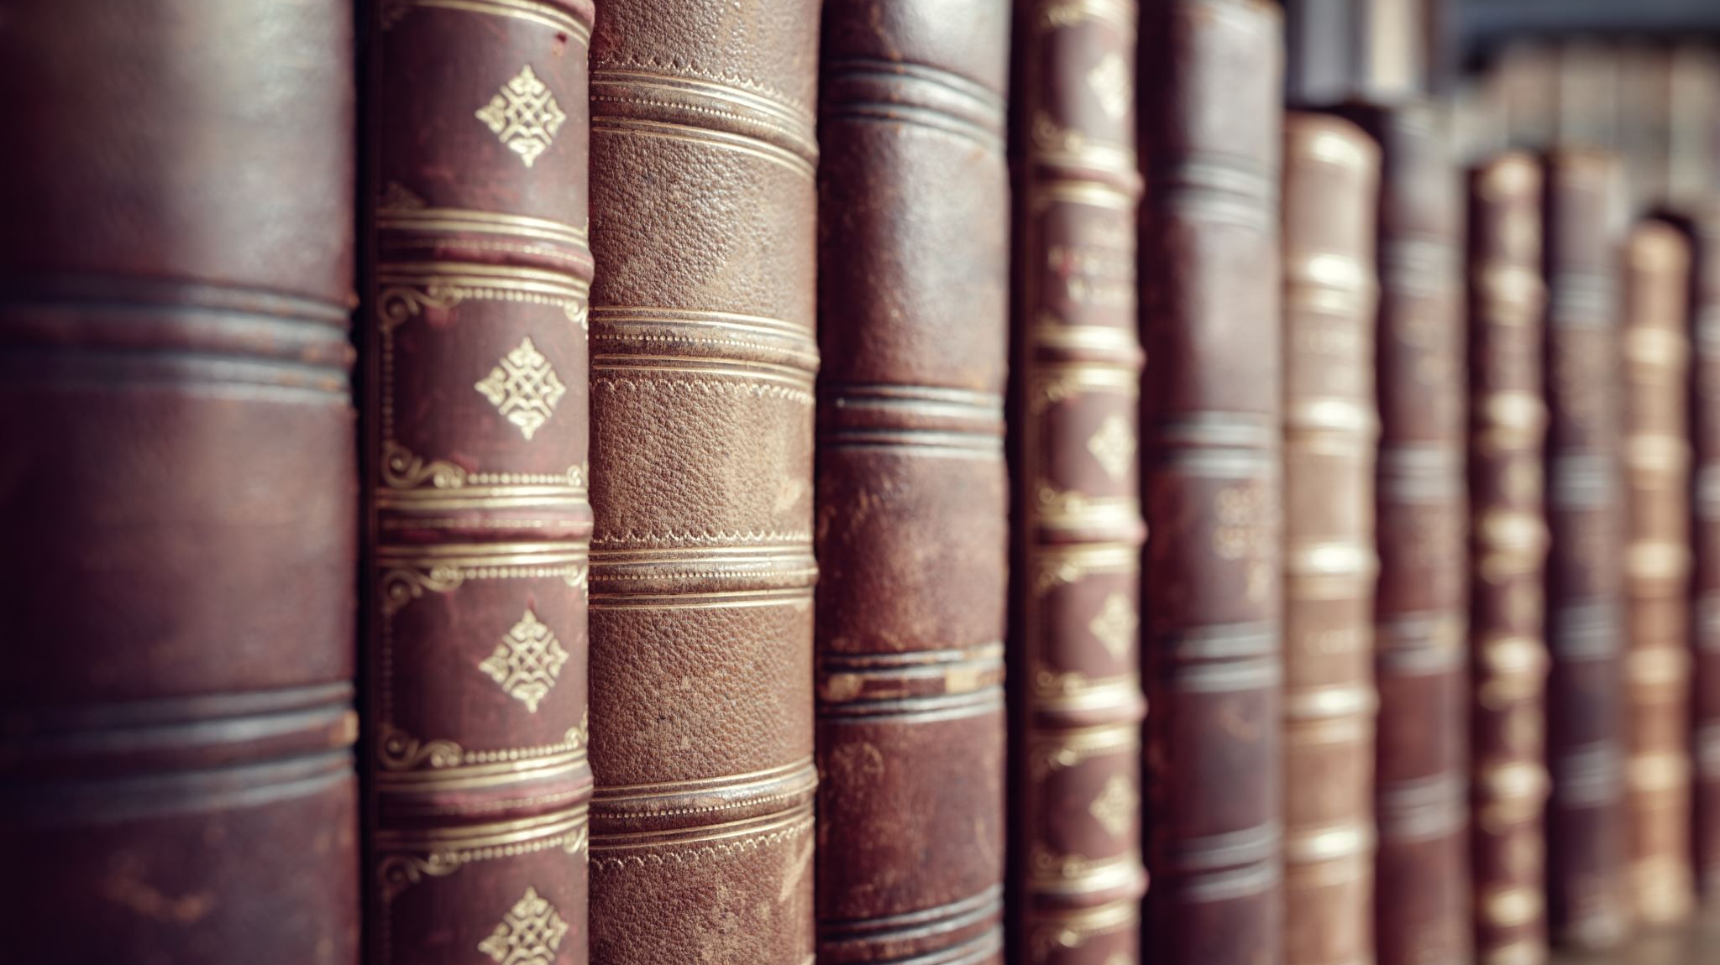
Literary History
5V
November 2023, December 2023, January 2024
Test in Testweek 2

Slide 2
At the end of these lessons, you …
can identify the different periods of English literature
can identify the characteristics of the different periods
can identify the main historical events that defined the literary periods
can identify the main authors and works of each period
have read and understood the 7 literary excerpts that were discussed in class
can answer questions on these excerpts
have read and understood a historical novel
can answer questions on your novel in literary terms (plot, title, setting, symbols, etc)
are able to place your chosen novel in its historical and literary context

Slide 3
Why do we read literature?

Slide 5
Literary Periods
Old English Period
500-1066
Middle English Period
1066-1500
Renaissance
1500-1660
The Regency
1811-1820
Romantic Period
1798-1870
Age of Reason -
Enlightenment
1660-1800
Victorian Period
1830-1900

Slide 6
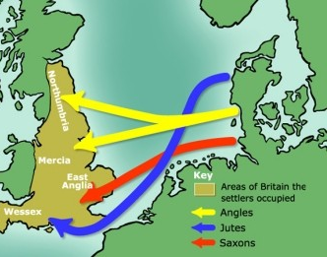
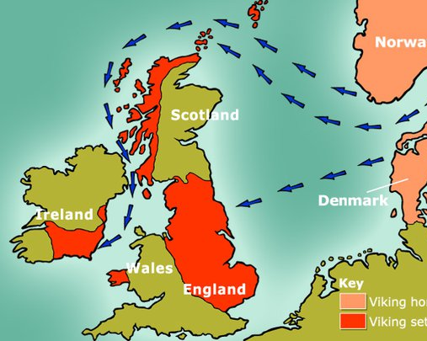
Old English Period 500-1066
History
410: The Romans withdraw from Britain. The Celts are not able to protect their borders. Invasion of Britain by Germanic tribes (Angles, Saxons, Jutes).
793: after period of relative peace, start of the Viking invasions
Literary Characteristics
Germanic influence: poems about kings and heroes.
Oral tradition
Use of alliteration
Literary works
Beowulf, author unknown. Longest known epic poem written in Old English (language spoken in Anglo Saxon Britain before 1066). The story was probably written down in the 11th century, though it takes place in 6th century Scandinavia.

Slide 7
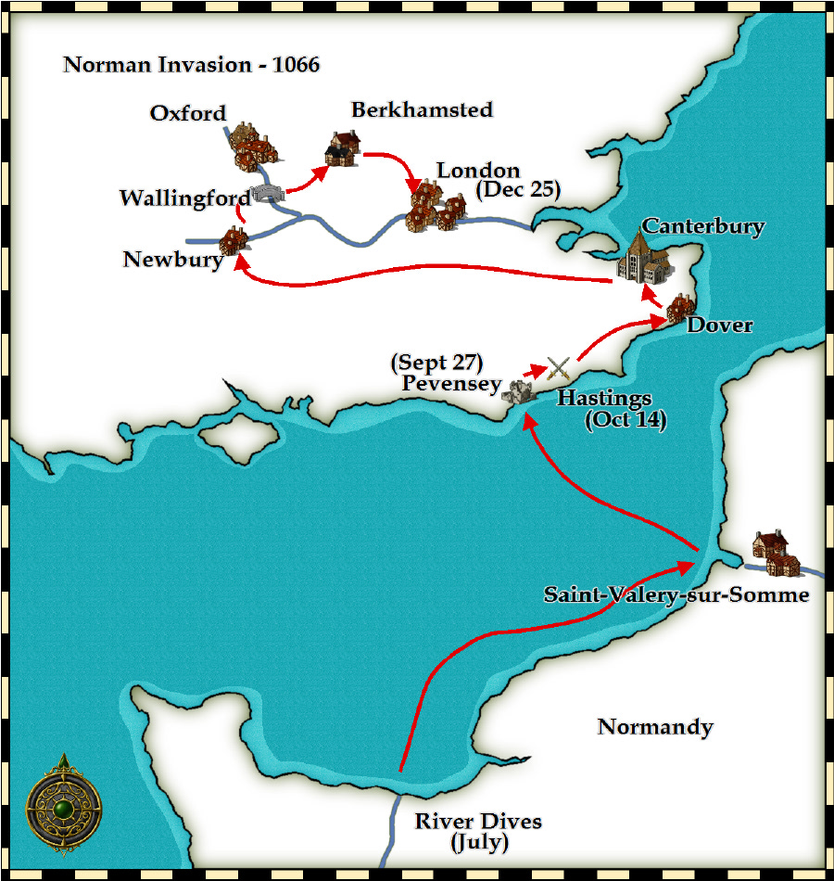
Middle English period 1066-1500
History
1066 King Edward the Confessor dies childless. Harold Godwinson (powerful English nobleman) and William of Normandy (who had been named as his successor by Edward) both claim the throne.
1066 Battle of Hastings is won by William “the Conqueror” of Normandy
French became language of higher circles of society, Anglo-Saxon English still spoken by common people
Literary characteristics
French influences
End rhyme instead of alliteration
More refined themes: courtly love instead of death, war and glory
More prominent position for women
Ideal is knight, not warrior
Ballads become popular, stories about King Arthur and his Knights of the round table
Invention of the printing press
Literary works
Geoffrey Chaucer’s The Canterbury Tales

Slide 8
The Renaissance 1500-1660
History
Starts late 15th, early 16th century (Tudor dynasty from 1485, Henry VII)
Came over from Italy and rest of Europe
Literary characteristics
Renewed interest in Ancient Roman and Greek cultures (seen as pagan in Middle Ages)
Antropomorphic (man-centred) instead of theocentric (god-centred)
Individual attitude instead of collective
Critical investigation instead of dogmatic belief
Rise of the printing press
Literary Works
Plays by William Shakespeare, such as Romeo & Juliet, Macbeth, Hamlet, etc
Sonnets by William Shakespeare, such as Sonnet 18: Shall I compare thee to a summer’s day
John Milton’s Paradise Lost
Edmund Spenser’s The Fairie Queene
Christopher Marlowe’s Doctor Faustus

Slide 10
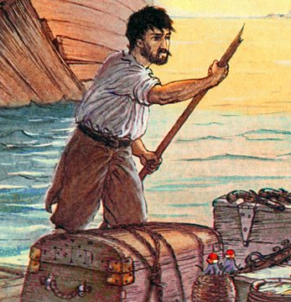
The Age of Reason/Enlightenment 1660-1800
History
The 18th century offered a wealth of knowledge, exploration and rapidly growing technology. Britain had become a rich nation thanks to its trade. During this Age of Reason people strongly believed in the power of critical thinking. Religious and political leaders began losing their influence on society. Logic and progress in science were seen as the answers to all life’s great questions of freedom, democracy and fundamental rights.
Literary characteristics
Rise of the novel (mostly morally uplifting and instructive novels promoting virtue, good sense, and universal benevolence, and introducing heroes who were no longer princes but representatives of the middle class.)
Value of human happiness; knowledge based on reason and evidence of the senses; ideals such as natural laws, progress, liberty,constituional government, separation of church and state.
Individual liberty and religious tolerance
“cogito, ergo sum”
Literary works
Jonathan Swift’s Gulliver’s Travels, first English novel, published in 1719
Daniel Defoe’s Robinson Crusoe

Slide 11
Robinson Crusoe by Daniel Defoe
The novel is about how the title character, Robinson Crusoe, becomes marooned on an island off the north-east coast of South America. As a young man, Crusoe had gone to sea in the hope of making his fortune. Crusoe is on a ship bound for Africa, where he plans to buy slaves for his plantations in South America, when the ship is wrecked on an island and Crusoe is the only survivor.
Alone on a desert island, Crusoe manages to survive thanks to his pluck and pragmatism. He keeps himself sane by keeping a diary, manages to build himself a shelter, and finds a way of salvaging useful goods from the wrecked ship, including guns.
The story is still relevant today and is often referenced in popular culture.

Slide 12
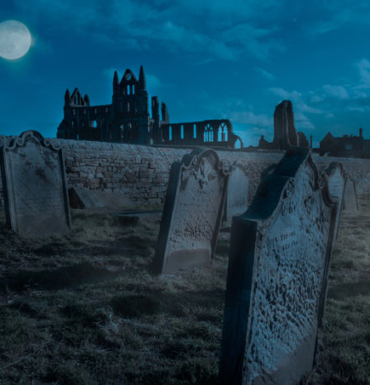
Romantic Period 1798-1870
History
The Romantic era was able to arise from the new wealth, stability, and sense of progress created by the Enlightenment. However, as a reaction, Romantic-era artists presented themselves against the social and political norms of the preceding period. They rejected reason, material wealth and scientific-technological knowledge and were more interested in feelings, imagination and spiritual growth. ‘Experiencing life’ became important; people used emotions rather than logic to base their decisions upon.
Literary characteristics
Superiority of imagination and creativity over
Romantic love
Individualism and solitude
The power and the grandeur of nature
A great interest in history and the exotic
Children as innocents
Gothic horror
Literary works
William Wordsworth & Samuel Taylor Coleridge - poetry: Lyrical Ballads (including We are Seven)
Bram Stoker: Dracula
Mary Shelley: Frankenstein
Charlotte Brontë: Jane Eyre
Emily Brontë: Wuthering Heights
Nathaniel Hawthorne: The Scarlet Letter (American!)
Herman Melville: Moby Dick (also: American Renaissance)
Edgar Allan Poe – poetry & short stories: Annabel Lee, The Fall of the House of Usher, The Raven (American!)

Slide 13
Dracula by Bram Stoker
'Dracula' is about a centuries-old Transylvanian vampire's visitation of England and the efforts to destroy him by a group of courageous men and women.
Wuthering Heights by Emily Brontë
In the wild, stormy countryside of the Yorkshire Moors, Lockwood asks his housekeeper, Nelly Dean, to tell him the story of Heathcliff and the strange denizens of Wuthering Heights.
It is a gothic novel that follows the antihero, Heathcliff, as he gets to revenge the people who kept him away from his love, Cathy Earnshaw.

Slide 14
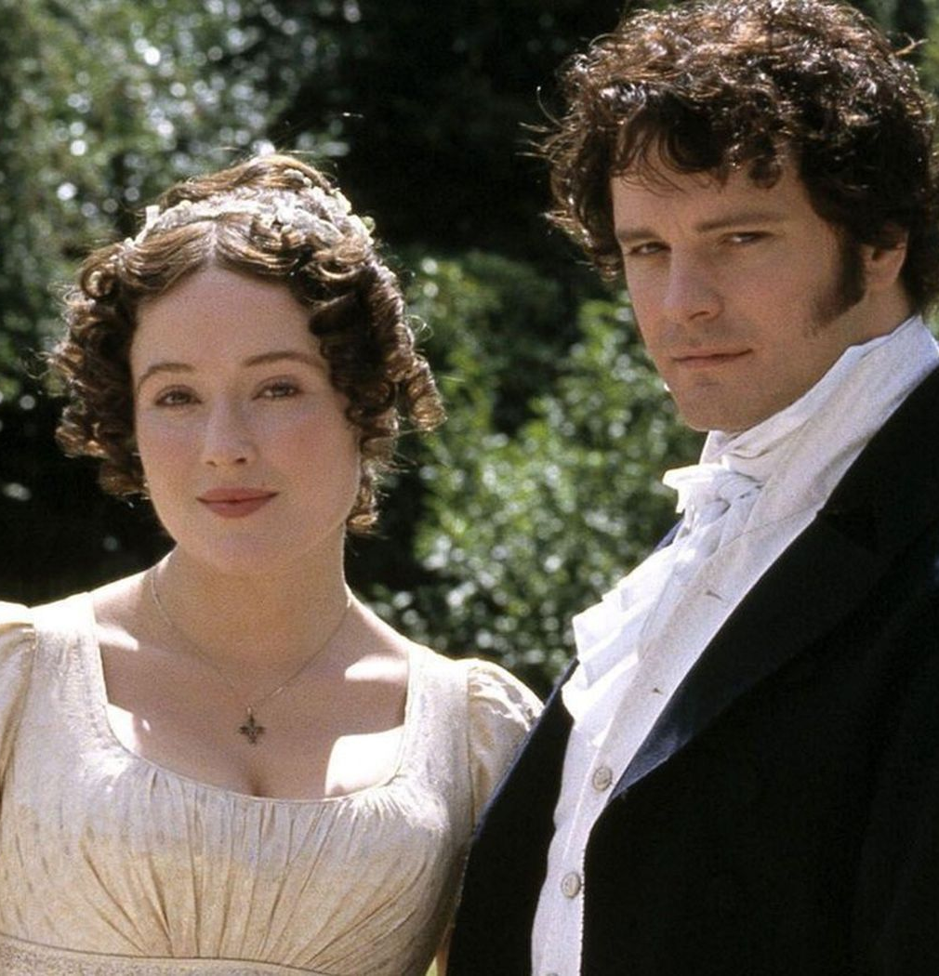
The Regency 1811-1820
History
Because King George III had become increasing insane, his son George, Prince of Wales, was appointed Regent to rule in his stead. When the King died in 1820, his son succeeded him as King George IV.
Although the Regency era is remembered as a time of refinement and culture, that was the preserve of the wealthy few, especially those in the Prince Regent's own social circle. For the masses, poverty was rampant as population began to concentrate due to industrial labour migration.
Literary characteristics
Social class
Focus on marriage
Attention to fashion and manners
Literary works
Sir walter Scott: Ivanhoe, Waverley
Keats, Shelley, Byron: Poetry
Jane Austen: Pride and Prejudice, Sense and Sensibility, Emma, Northanger Abbey, Persuasion

Slide 15
Emma by Jane Austen
the novel centres on Emma Woodhouse, a precocious young woman whose misplaced confidence in her matchmaking abilities occasions several romantic misadventures.
Many of Jane Austen’s novels have been retold in books or film. Clueless, for instance, is a modern retelling of Emma.

Slide 16
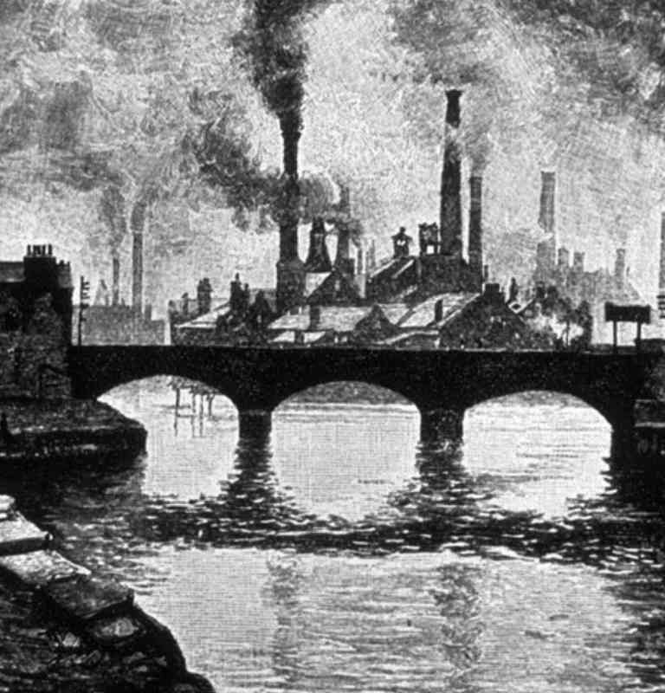
The Victorian Period 1830-1900
History
This period is named after Queen Victoria, who ruled the United Kingdom from 1837 to 1901. It was a time of scientific progress: major discoveries were made in all branches of science, including physics, astronomy, natural history and medicine. But it was also a time of hardship and struggle. The Victorian age was a dark period for children in England, who were forced to work under extremely dangerous conditions in the new mines and factories which developed rapidly. The Industrial Revolution created a huge gap between the haves and have-nots.
Literary characteristics
depictions of everyday people, hard lives, and moral lessons
Realism
Books written/read in installments by common people
Reaction to rapid changes in society
Literary works
Charles Dickens: Great Expectations, Oliver Twist, Hard Times, Nicholas Nickleby, David Copperfield, The Pickwick Papers, Bleak House, Little Dorrit, A Christmas Carol, A Tale of Two Cities
Charlotte Brontë: Jane Eyre
George Eliot: Middlemarch, The Mill on the Floss, Silas Marner
Thomas Hardy: Tess of the D’Urbervilles, The Mayor of Casterbridge
Oscar Wilde: The Picture of Dorian Gray

Slide 18
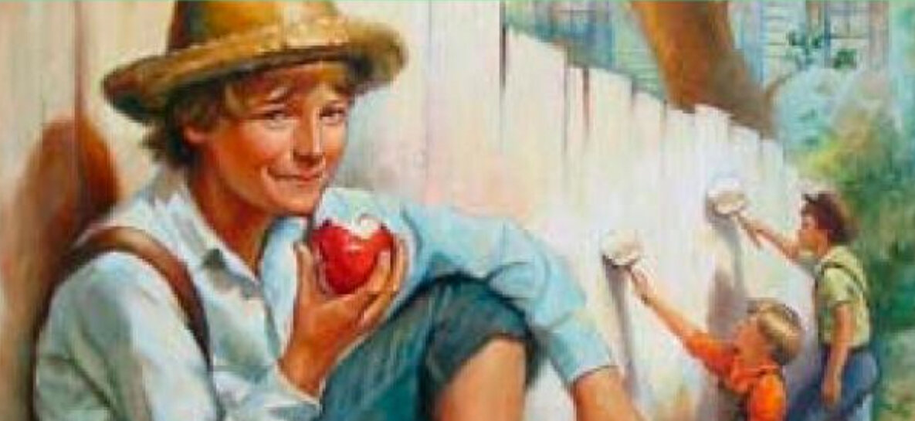
The Great American Novel
The American Renaissance (1830-1870): Herman Melville: Moby Dick
Romanticism (1830-1860): Nathaniel Hawthorne: The Scarlet Letter
American Realism/Regionalism: Mark Twain: The Adventures of Tom Sawyer (1876), The Adventures of Huckleberry Finn (1884)
Realism/War novel: Stephen Crane: The Red Badge of Courage (1895)

Slide 19
Literary Periods
Old English Period
500-1066
Middle English Period
1066-1500
Renaissance
1500-1660
The Regency
1811-1820
Romantic Period
1798-1870
Age of Reason
Enlightenment
1660-1800
Victorian Period
1830-1900

Slide 20
The following novels can be chosen:
The Age of Reason/The Enlightenment:
Jonathan Swift’s Gulliver’s Travels, first English novel, published in 1719
Daniel Defoe’s Robinson Crusoe
The Romantic Period:
Bram Stoker: Dracula
Mary Shelley: Frankenstein
Charlotte Brontë: Jane Eyre
Emily Brontë: Wuthering Heights
Nathaniel Hawthorne: The Scarlet Letter (American!)
Herman Melville: Moby Dick (also: American Renaissance)
The Regency:
Jane Austen: Pride and Prejudice, Sense and Sensibility, Emma, Northanger Abbey, Persuasion
The Victorian Age:
Charles Dickens: Great Expectations, Oliver Twist, Hard Times, Nicholas Nickleby, David Copperfield, The Pickwick Papers, Bleak House, Little Dorrit, A Christmas Carol, A Tale of Two Cities
Charlotte Brontë: Jane Eyre
George Eliot: Middlemarch, The Mill on te Floss, Silas Marner
Thomas Hardy: Tess of the D’Urbervilles, The Mayor of Casterbridge
Oscar Wilde: The Picture of Dorian Gray
The Great American Novel of the 19th century:
The American Renaissance (1830-1870): Herman Melville: Moby Dick
Romanticism (1830-1860): Nathaniel Hawthorne: The Scarlet Letter
American Realism/Regionalism: Mark Twain: The Adventures of Tom Sawyer (1876), The Adventures of Huckleberry Finn (1884)
Realism/War novel: Stephen Crane: The Red Badge of Courage (1895)

Slide 21
The Age of Reason:
Gulliver’s travels by Jonathan Swift
Gulliver's Travels is an adventure story (in reality, a misadventure story) involving several voyages of Lemuel Gulliver, a ship's surgeon, who, because of a series of mishaps en route to recognized ports, ends up, instead, on several unknown islands living with people and animals of unusual sizes, behaviors, and philosophies, but who, after each adventure, is somehow able to return to his home in England where he recovers from these unusual experiences and then sets out again on a new voyage.

Slide 22
The Age of Reason:
Robinson Crusoe by Daniel Defoe
The novel is about how the title character, Robinson Crusoe, becomes marooned on an island off the north-east coast of South America. As a young man, Crusoe had gone to sea in the hope of making his fortune. Crusoe is on a ship bound for Africa, where he plans to buy slaves for his plantations in South America, when the ship is wrecked on an island and Crusoe is the only survivor.
Alone on a desert island, Crusoe manages to survive thanks to his pluck and pragmatism. He keeps himself sane by keeping a diary, manages to build himself a shelter, and finds a way of salvaging useful goods from the wrecked ship, including guns.
The story is still relevant today and is often referenced in popular culture.

Slide 23
The Romantics:
Frankenstein by Mary Shelley
Frankenstein tells the story of gifted scientist Victor Frankenstein who succeeds in giving life to a being of his own creation. However, this is not the perfect specimen he imagines that it will be, but rather a hideous creature who is rejected by Victor and mankind in general.

Slide 24
The Romantics/The Victorian Period:
Jane Eyre by Charlotte Brontë
It follows the life of an orphan girl, Jane. We learn that even though Jane is a simple and plain girl, she has been battling struggles all her life. The story takes us through her transformation from an isolated orphan to a strong independent woman. Jane's childhood has been full of struggles and hardships.

Slide 25
The Romantics:
The Scarlet Letter by Nathaniel Hawthorne
Set in the Puritan Massachusetts Bay Colony during the years 1642 to 1649, the novel tells the story of Hester Prynne, who conceives a daughter with a man to whom she is not married and then struggles to create a new life of repentance and dignity. As punishment, she must wear a scarlet letter 'A' (for "adultery").

Slide 26
The Romantics:
Moby Dick by Herman Melville
Herman Melville's Moby Dick is the story of Captain Ahab's self-destructive obsession with the white whale called Moby Dick. It is told through the narration of Ishmael, a sailor new to Ahab's ship, the Pequod. The plot of the novel follows Ahab's manic drive to kill the whale, even as it endangers his crew.

Slide 27
The Romantics: Dracula by Bram Stoker
'Dracula' is about a centuries-old Transylvanian vampire's visitation of England and the efforts to destroy him by a group of courageous men and women.
The Romantics: Wuthering Heights by Emily Brontë
In the wild, stormy countryside of the Yorkshire Moors, Lockwood asks his housekeeper, Nelly Dean, to tell him the story of Heathcliff and the strange denizens of Wuthering Heights.
It is a gothic novel that follows the antihero, Heathcliff, as he gets to revenge the people who kept him away from his love, Cathy Earnshaw.

Slide 28
The Regency:
Emma by Jane Austen
the novel centres on Emma Woodhouse, a precocious young woman whose misplaced confidence in her matchmaking abilities occasions several romantic misadventures.
Many of Jane Austen’s novels have been retold in books or film. Clueless, for instance, is a modern retelling of Emma.

Slide 29
The Regency:
Pride and Prejudice by Jane Austen
Pride and Prejudice follows the turbulent relationship between Elizabeth Bennet, the daughter of a country gentleman, and Fitzwilliam Darcy, a rich aristocratic landowner. They must overcome the titular sins of pride and prejudice in order to fall in love and marry.

Slide 30
The Regency: Sense and Sensibility by Jane Austen
The novel follows the three Dashwood sisters and their widowed mother as they are forced to leave the family estate at Norland Park and move to Barton Cottage, a modest home on the property of distant relative Sir John Middleton. There Elinor and Marianne experience love, romance, and heartbreak.

Slide 31
The Regency:
Persuasion by Jane Austen
Persuasion tells the story of a second chance, the reawakening of love between Anne Elliot and Captain Frederick Wentworth, whom eight years earlier she had been persuaded not to marry. Wentworth returns from the Napoleonic Wars with prize money and the social acceptability of naval rank.

Slide 32
The Regency:
Northanger Abbey by Jane Austen
Northanger Abbey is about a young woman, Catherine Morland, who goes to Bath with her aunt and uncle, Mrs. & Mr. Allen. While in Bath, Catherine meets Henry Tilney, who she falls in love with, and Isabella Thorpe and Eleanor Tilney, who she befriends.

Slide 33
The Romantics/The Victorian Period:
Jane Eyre by Charlotte Brontë
It follows the life of an orphan girl, Jane. We learn that even though Jane is a simple and plain girl, she has been battling struggles all her life. The story takes us through her transformation from an isolated orphan to a strong independent woman. Jane's childhood has been full of struggles and hardships.

Slide 34
The Victorian Age:
Great Expectations by Charles Dickens
Charles Dickens's Great Expectations tells the story of Pip, an English orphan who rises to wealth, deserts his true friends, and becomes humbled by his own arrogance. It also introduces one of the more colorful characters in literature: Miss Havisham. Charles Dickens set Great Expectations during the time that England was becoming a wealthy world power. Machines were making factories more productive, yet people lived in awful conditions, and such themes carry into the story.

Slide 35
The Victorian Age:
Oliver Twist by Charles Dickens
The story follows the titular orphan, who, after being raised in a workhouse, escapes to London, where he meets a gang of juvenile pickpockets led by the elderly criminal Fagin, discovers the secrets of his parentage, and reconnects with his remaining family.

Slide 36
The Victorian Age:
Bleak House by Charles Dickens
The expansive narrative covers many plots, including the first-person account of the life of Esther Summerson and an ongoing court case concerning a large inheritance thrown into chaos by the existence of contradictory wills.

Slide 37
The Victorian Age:
David Copperfield by Charles Dickens
Written from the first-person perspective of its eponymous narrator, the novel recounts his experiences from boyhood to manhood. Because many of these experiences closely mirror the life of Charles Dickens, David Copperfield is widely considered both a bildungsroman and an autobiographical novel. In addition to being Dickens’ favorite among his own works, the novel has been praised for its sensitive consideration of Victorian social issues, including poverty, class hierarchy, immigration, and the treatment of “fallen women.”

Slide 38
The Victorian Age:
Hard Times by Charles Dickens
"Hard Times" takes place in a fictional factory town named Coketown and follows the lives of a group of people who are intertwined somehow. The novel reflects how the characters' choices lead them to an ending ultimately of their choosing.

Slide 39
The Victorian Age:
Nicholas Nickleby by Charles Dickens
Upon the death of his father, 19-year-old Nicholas Nickleby is sent by his uncle, Ralph Nickleby, a mean-spirited moneylender, to serve as an assistant teacher at Dotheboys Hall. The school is run by the ruthless Wackford Squeers who is notorious for his cruelty toward the school’s 40 unfortunate pupils. Outraged by Squeers’s treatment of the boys, Nickleby attacks Squeers and then flees, taking Squeers’s main victim, a simple-minded boy named Smike, with him. Nickleby and Smike become involved in a series of adventures while Ralph Nickleby continues to plot against his nephew. Although comic elements help lighten some of the plot’s darker moments and the novel concludes with a happy and just ending, Nicholas Nickleby is a sharp and moving social critique.

Slide 40
The Victorian Age:
The Pickwick Papers by Charles Dickens
The Pickwick Papers chronicles the adventures of the members of the Pickwick Club, a group of travelers who journey around England and share their experiences. Because of the original serial format of the novel, the chapters contain individual but interconnected episodes charting the club's exploits.

Slide 41
The Victorian Age: Little Dorrit by Charles Dickens
The novel attacks the injustices of the contemporary English legal system, particularly the institution of debtors' prison. Amy Dorrit, referred to as Little Dorrit, is born in and lives much of her life at the Marshalsea prison, where her father is imprisoned for debt.

Slide 42
The Victorian Age: A Tale of Two Cities by Charles Dickens
A Tale of Two Cities tells the stories of two connected families in 18th-century London and Paris, exploring everything from love and loss to murder and family intrigue, thus teaching us about history, ethics, and the complexity of human relationships.

Slide 43
The Victorian Age:
Middlemarch by George Eliot
Middlemarch is a novel that explores the dynamics of marriage and social class in 19th-century England. A large web of characters, including the main stories of Dorothea Brooke and Dr. Lydgate, intersect with a number of related plotlines.

Slide 44
The Victorian Age:
Silas Marner by George Eliot
Silas Marner is a novel by George Eliot that tells the story of a lonely and embittered weaver who finds redemption and happiness when he adopts a young girl. It highlights the transformative power of love and community.

Slide 45
The Victorian Age:
The Mill on the Floss by George Eliot
Protagonist Maggie Tulliver and Maggie's brother, Tom, have a very close relationship after growing up together at Dorlcote Mill on the River Floss. The mill has been in the family for generations, but Mr. Tulliver wants more for his son, Tom, so he sends Tom for formal schooling.

Slide 46
The Victorian Age:
Tess of the D’Urbervilles by Thomas Hardy
Tess, attractive and innocent, is seduced by family's dissolute heir, Alec d'Urberville, and secretly bears a child, Sorrow, who dies in infancy. Later working as a dairymaid, she meets and marries Angel Clare, an idealistic man who rejects Tess after learning of her sexual past on their wedding night.

Slide 47
The Victorian Age:
The Mayor of Casterbridge by Thomas Hardy
The novel tells of the rise and fall of Michael Henchard, who, starting from nothing after abandoning his wife and daughter, gains prosperity and respect and is reunited with his family only to lose everything through his own wrong-headedness, his vengeful nature, and a spate of bad luck.

Slide 48
The Victorian Age:
The Picture of Dorian Gray by Oscar Wilde
The Picture of Dorian Gray tells about a young man named Dorian Gray who has a portrait painted of himself. The artist, Basil Hallward, thinks Dorian Gray is very beautiful, and becomes obsessed with Dorian. One day in Basil's garden, Dorian Gray meets a man named Lord Henry Wotton. Lord Henry Wotton makes Dorian Gray believe that the only thing important in life is beauty. However, Dorian realizes that he will become less beautiful as he grows older. He wishes the portrait Basil painted would become old in his place. Dorian then sells his soul so he can be beautiful forever, but not on purpose.

Slide 49
The Great American Novel:
The Adventures of Tom Sawyer by Mark Twain
The novel follows the rebellious Tom Sawyer during his formative years as he begins to mature out of his childish, troublemaking behavior. This is mostly seen during the harrowing events of Tom's encounters with Injun Joe as well as his forays alongside his ne'er-do-well friend, Huckleberry Finn.

Slide 50
The Great American Novel:
The Adventures of Huckleberry Finn by Mark Twain
Huck Finn, the protagonist, escapes his abusive and drunken father and runs away with a slave named Jim. The two have many adventures on a raft on the Mississippi River, including traveling with the antagonists, the king and the duke, two con artists who go from town to town stealing from people.

Slide 51
The Great American Novel:
The Red Badge of Courage by Stephen Crane
The Red Badge of Courage is the story of Henry Fleming, a teenager who joins the Union army because he is enamored with the romance of battle. When the actual fighting starts, Henry is worried that he'll run away. At the beginning of the battle, Henry fights, as a soldier must.

Slide 52
The Romantics/The Great American Novel:
Moby Dick by Herman Melville
Herman Melville's Moby Dick is the story of Captain Ahab's self-destructive obsession with the white whale called Moby Dick. It is told through the narration of Ishmael, a sailor new to Ahab's ship, the Pequod. The plot of the novel follows Ahab's manic drive to kill the whale, even as it endangers his crew.

Slide 53
The Romantics/The Great American Novel:
The Scarlet Letter by Nathaniel Hawthorne
Set in the Puritan Massachusetts Bay Colony during the years 1642 to 1649, the novel tells the story of Hester Prynne, who conceives a daughter with a man to whom she is not married and then struggles to create a new life of repentance and dignity. As punishment, she must wear a scarlet letter 'A' (for "adultery").

Slide 54
The following novels can be chosen:
The Age of Reason/The Enlightenment:
Jonathan Swift’s Gulliver’s Travels, first English novel, published in 1719
Daniel Defoe’s Robinson Crusoe
The Romantic Period:
Bram Stoker: Dracula
Mary Shelley: Frankenstein
Charlotte Brontë: Jane Eyre
Emily Brontë: Wuthering Heights
Nathaniel Hawthorne: The Scarlet Letter (American!)
Herman Melville: Moby Dick (also: American Renaissance)
The Regency:
Jane Austen: Pride and Prejudice, Sense and Sensibility, Emma, Northanger Abbey, Persuasion
The Victorian Age:
Charles Dickens: Great Expectations, Oliver Twist, Hard Times, Nicholas Nickleby, David Copperfield, The Pickwick Papers, Bleak House, Little Dorrit, A Christmas Carol, A Tale of Two Cities
Charlotte Brontë: Jane Eyre
George Eliot: Middlemarch, The Mill on te Floss, Silas Marner
Thomas Hardy: Tess of the D’Urbervilles, The Mayor of Casterbridge
Oscar Wilde: The Picture of Dorian Gray
The Great American Novel of the 19th century:
The American Renaissance (1830-1870): Herman Melville: Moby Dick
Romanticism (1830-1860): Nathaniel Hawthorne: The Scarlet Letter
American Realism/Regionalism: Mark Twain: The Adventures of Tom Sawyer (1876), The Adventures of Huckleberry Finn (1884)
Realism/War novel: Stephen Crane: The Red Badge of Courage (1895)

